Slide 1
FRONT DESK SYSTEM
The University of Texas at El Paso(UTEP)
CHRISTIAN GOMEZ
ALAN VERDIN
GARRETT JONES
MIGUEL RODARTE

Slide 2
INDEX
SCOPE - SLIDE 3
REQUIREMENTS - SLIDE 4
ASSUMPTIONS - SLIDE 5
ER DIAGRAM - SLIDE 6
NORMALIZED SCHEMA - SLIDE 7
WEB STRUCTURE - SLIDE 8
TABLES & VIEWS - SLIDES 9 - 22
PROCEDURES - SLIDES 23 - 39
FILTER REQUEST - SLIDES 24 - 25
CREATE REQUEST - SLIDES 26 - 33
UPDATE REQUEST - SLIDES 34 - 36
DELETE REQUEST - SLIDES 37 -39

Slide 3
SCOPE
We have been hired by the University of Texas at El Paso to create a system that logs requests to the front desk. The system will allow visitors such as students, staff, faculty, and guests to make at least one or multiple request(s). The requests can be made by email, phone, or walk-in. Email or phone requests must be entered into the system by an assistant from the front desk, otherwise the visitor will be able to interact directly with the system. Staff members will be responsible for creating and filling in the request in case where the request is type email or phone. The system will ask the visitor to input data such as name, type of visitor and a description of the problem. The date and time can be assigned by the system. The visitor can have/enter more than one phone number. If the requester information is removed, the requests made by that requester must also be removed. Once the request is completed then it will be sent to the service department.
A friendly user interface needs to be made to accompany the system. It will be friendly for the user by providing exact input locations with adequate labels to prevent confusion or input errors. The interface will allow the staff from the front desk or visitor to properly input the visitor's data from the request in a fast paced and error-free manner. Once the data is submitted to the system, assistants will be able to make a change of request status, forward the request to the designated service and receive assistance from the desired service.
The data relevant for the system ranges from the visitor’s personal information such as full name, id, email, phone number and visitor type; staff, faculty, student, or guest. This will help the system properly identify the visitor. The system will take in the user’s description of the problem and indicate a forward to selection. The selection will help direct the user request to the correct service, the services and their designated staff will be part of the data file. Having this information in a data file will allow the staff to add/remove services as well as staff.
The system will collect the most important data such as time/days the front desk received more requests, the number of requests attended per day, the number of visitors assisted per day or week, most common type of visitor, most common type of request, most common request category, and number of requests done by each category. Collected data will be reported per day and week.

Slide 4
REQUIREMENTS
R1. The system shall record the first name, last name, email, phone number and ID of each visitor.
R2. The system shall assign a unique ID for each request. This ID will be used to track the request much faster in the database.
R3. The system shall allow visitors and staff to cancel a request.
R4. The system will assign a pending status by default when a
request is done by a visitor.
R5. The system will provide a list of options to declare if the request was done by email, phone, or walk-in.
R6. Only staff members will be able to modify the status of the request, if needed.
R7. The system shall allow staff members to change any information from the request. For example: A wrong or bad description about the problem, incorrect or missing information.
R8. The system shall allow assistant personnel to generate reports about the most common requests, the total count of each type of request (email, phone, walk-in), days with more visits, most common type of visitors, view of all the requests, view of all deleted requests, all request done by a type of visitor, and provide a report menu.
R9. The system shall allow the assistant attending a request to change the request’s status from pending to “in progress”,” cancel”, or “done”.
R10. The system will provide a user-friendly interface where the visitor can find and create a request easily. This will be implemented by adding color buttons and clear text messages specifying what that buttons does.

Slide 5
ASSUMPTIONS
A1. Visitors can make multiple requests.
A2. Each request will be assigned by only one staff member.
A3. Each request will have a unique ID number.
A4. Staff members or visitors can cancel the request if they want to
A5. In case a staff member cancels a request, this one will provide reasons/feedback to the visitor.

Slide 6
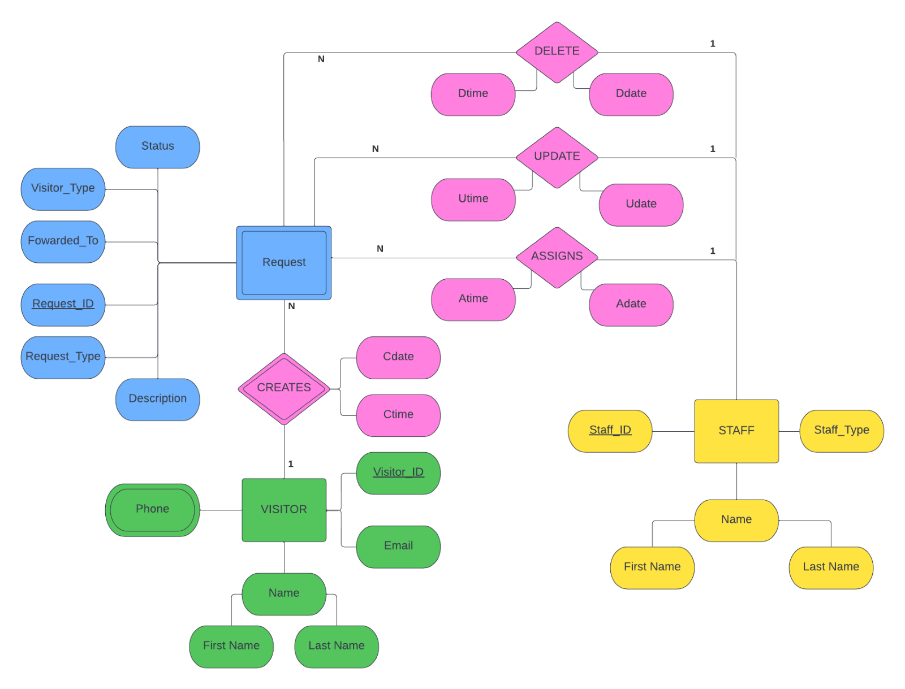
DESIGN(ER Diagram)

Slide 7
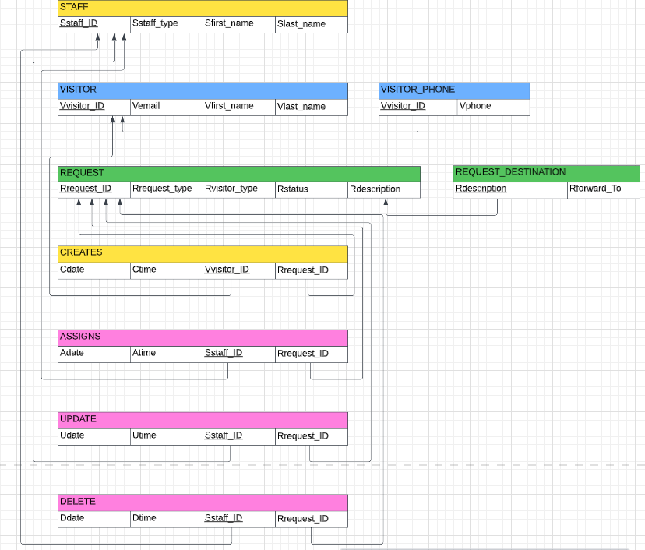
DESIGN(Normalized Schema)

Slide 8
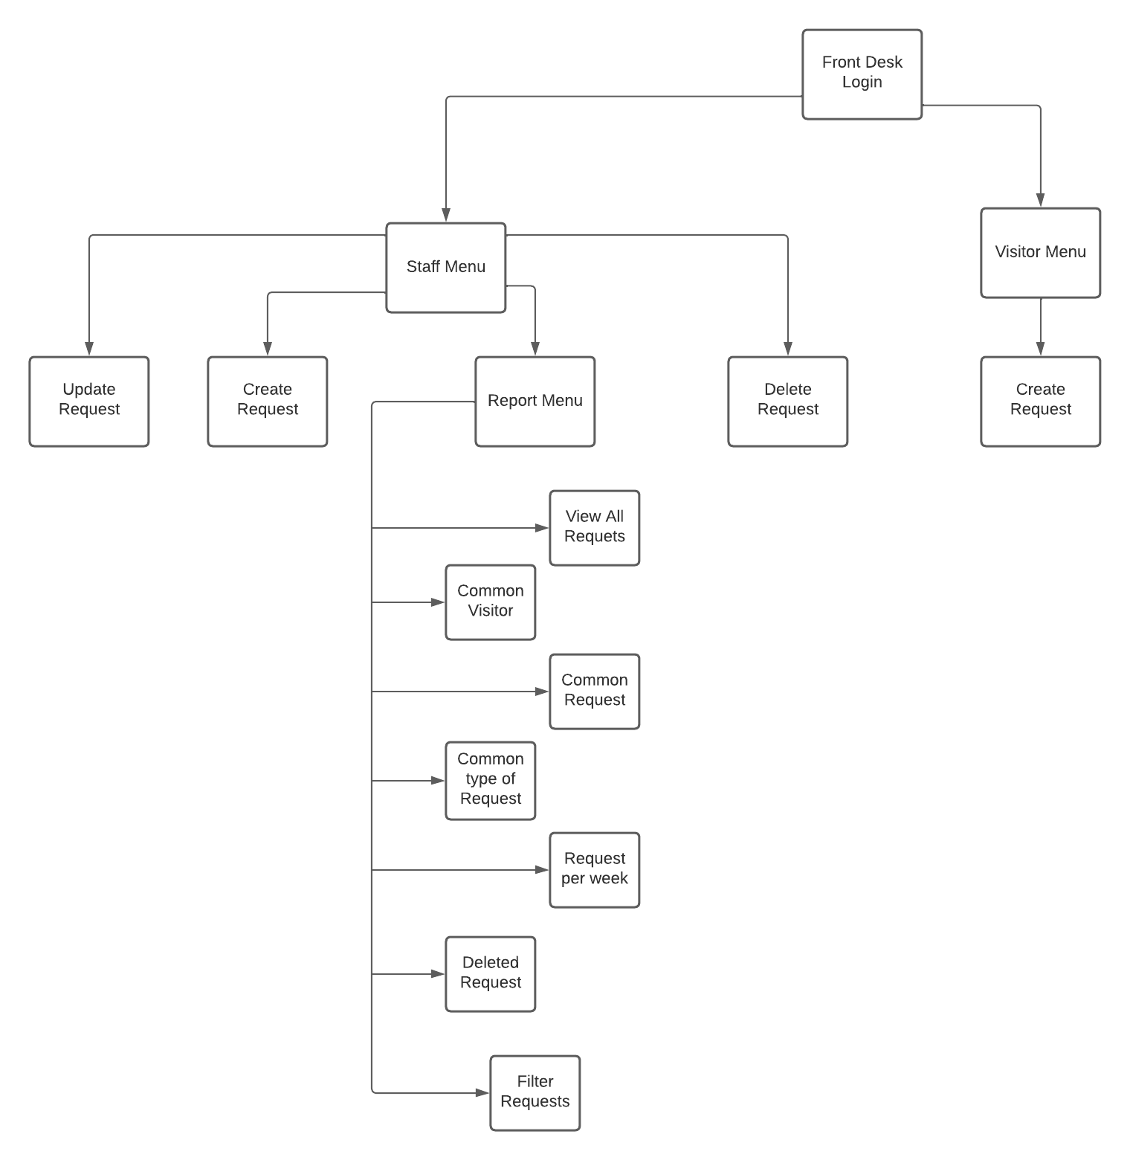
DESIGN(Website structure)

Slide 9
TABLES & VIEWS
The next slides will show the most used tables of our project as well as the views created.
The views will include not only the table but their functionality in the web interface.
Views:
Most Common Visitor Type
Most Common Request Type
Most Common Description
Most Common Request Per Time Period

Slide 10
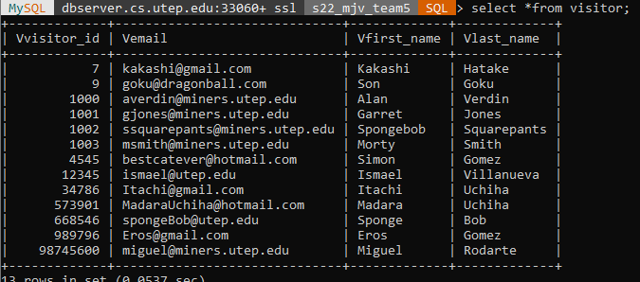
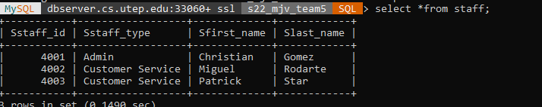
VISITORS & STAFF TABLE

Slide 11
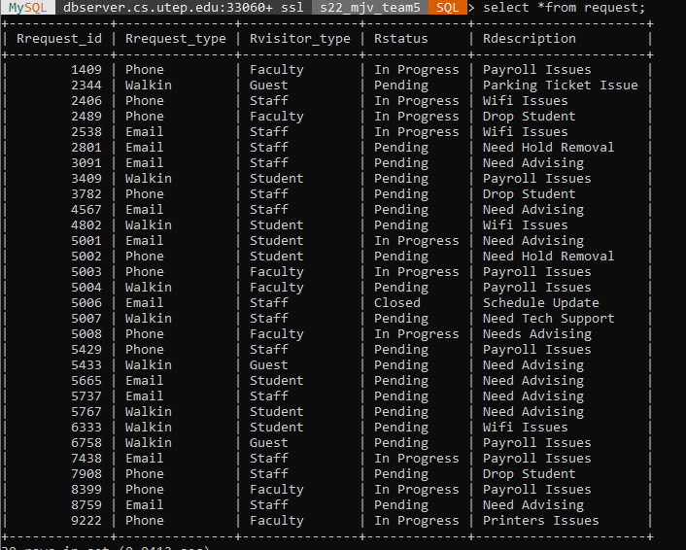
REQUEST TABLE

Slide 12
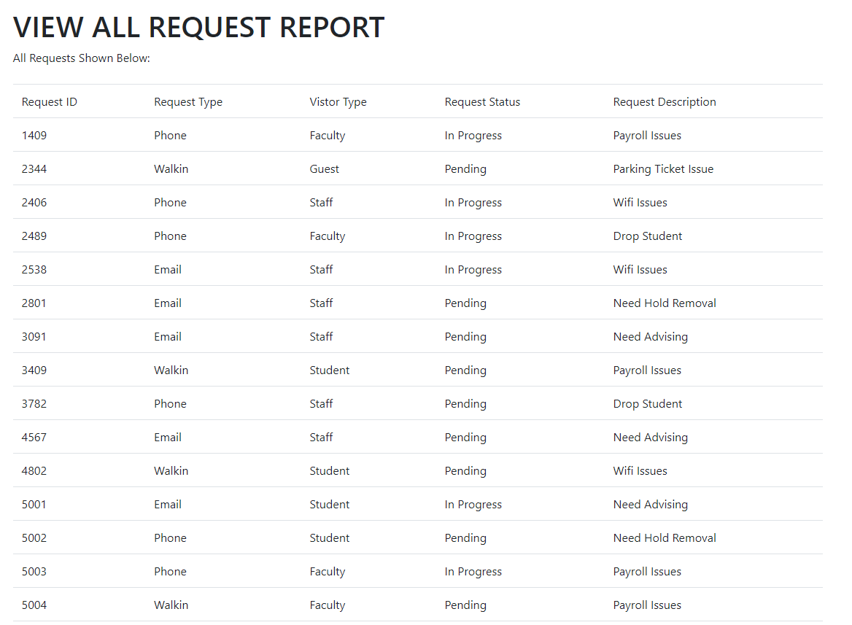
REQUEST TABLE

Slide 13
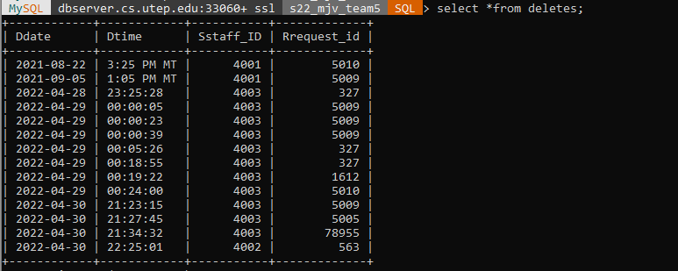
DELETES TABLE

Slide 14
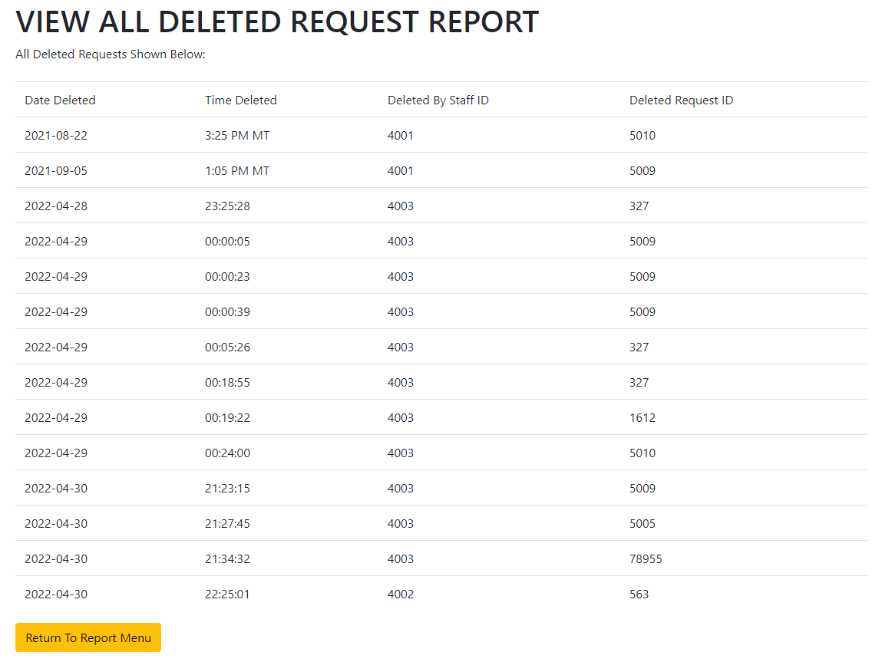
DELETES TABLE

Slide 15
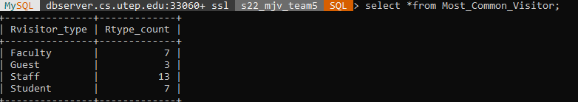
MOST COMMON VISITOR VIEW

Slide 16
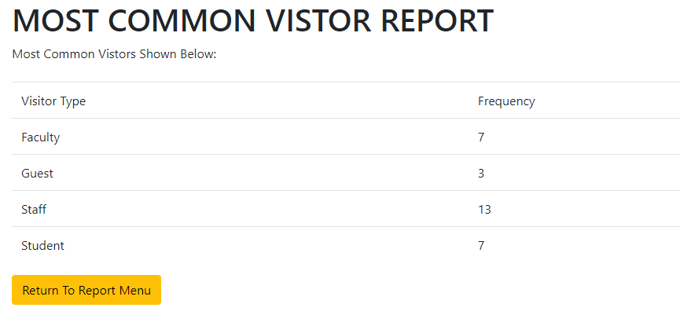
MOST COMMON VISITOR VIEW

Slide 17
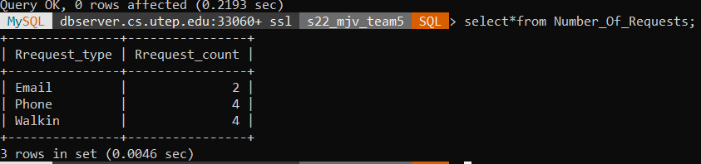
MOST COMMON REQUEST TYPE VIEW

Slide 18
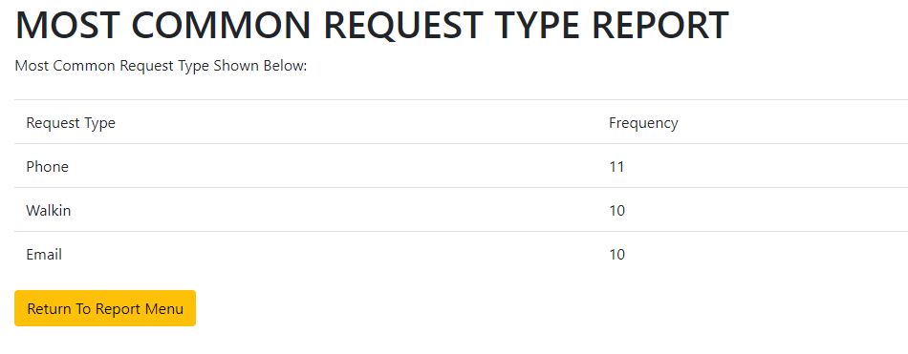
MOST COMMON REQUEST TYPE VIEW

Slide 19
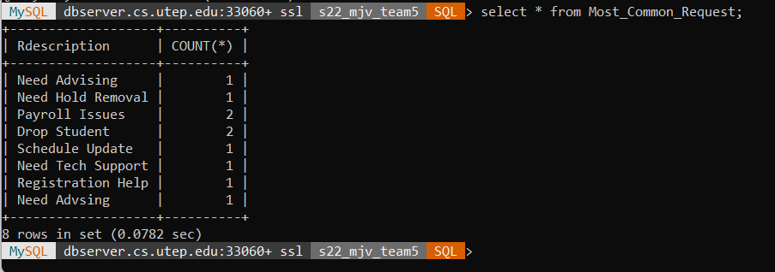
MOST COMMON REQUEST DESCRIPTION VIEW

Slide 20
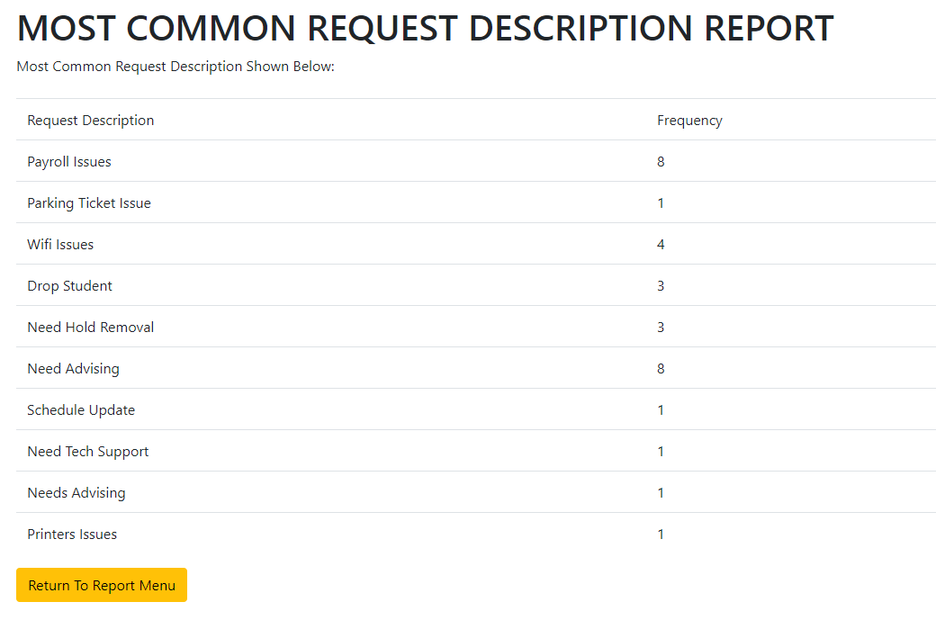
MOST COMMON REQUEST DESCRIPTION VIEW

Slide 21
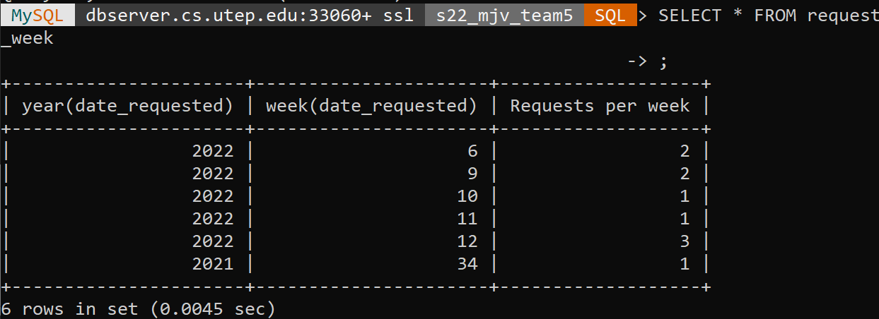
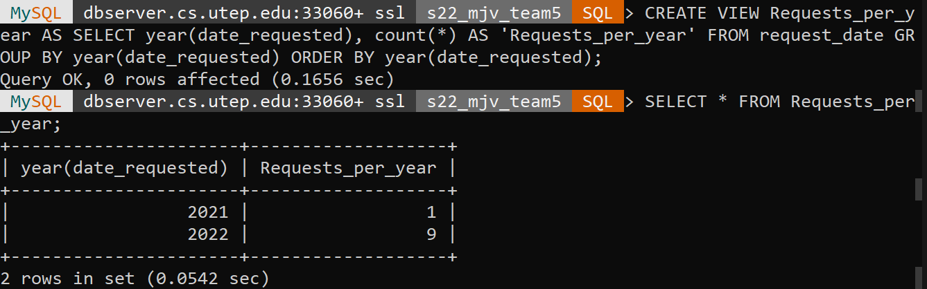
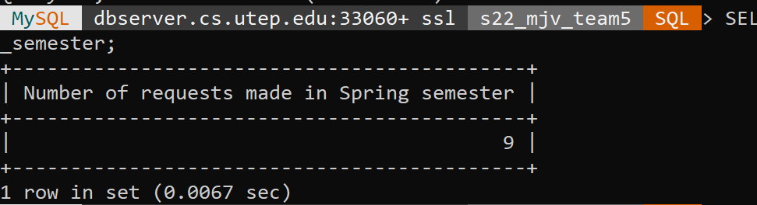
MOST COMMON REQUEST PER TIME PERIOD VIEW

Slide 22
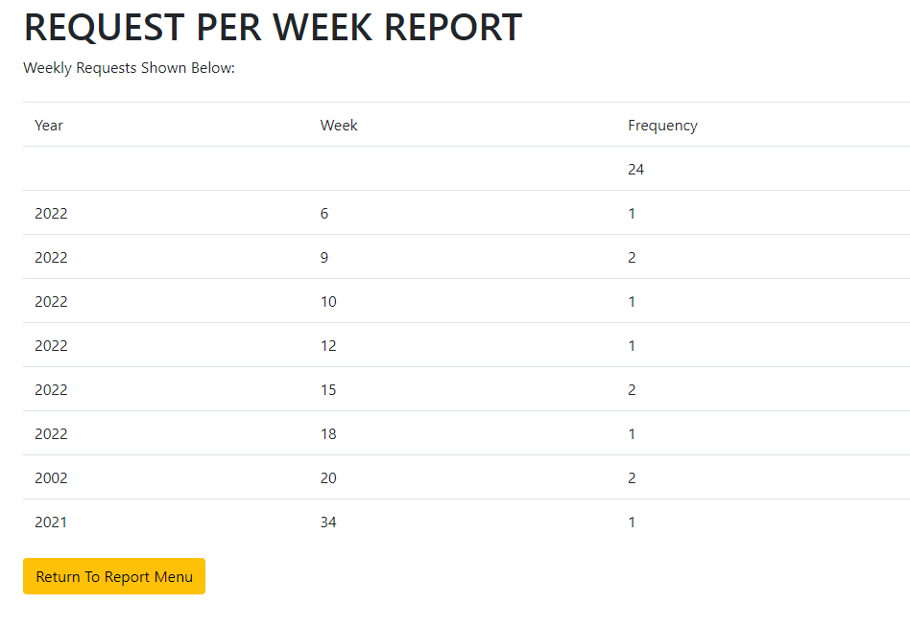
MOST COMMON REQUEST PER TIME PERIOD VIEW

Slide 23
PROCEDURES
The procedures for our project Front Desk consisted of the following:
Create Request Procedure
Update Request Procedure
Delete Request Procedure
Filter Request By Visitor Type
The next slides will show the procedures in action throughout the web interface.

Slide 24
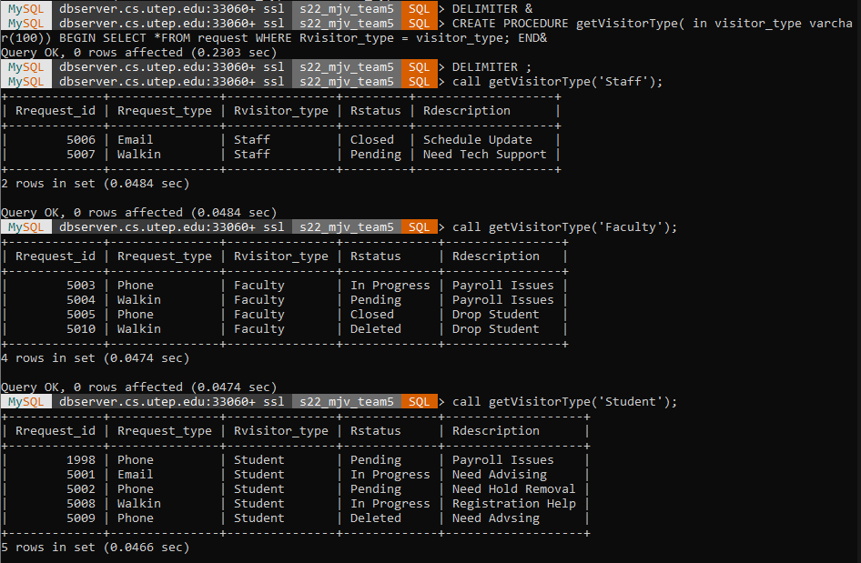
FILTER REQUEST BY VISITOR PROCEDURE

Slide 25
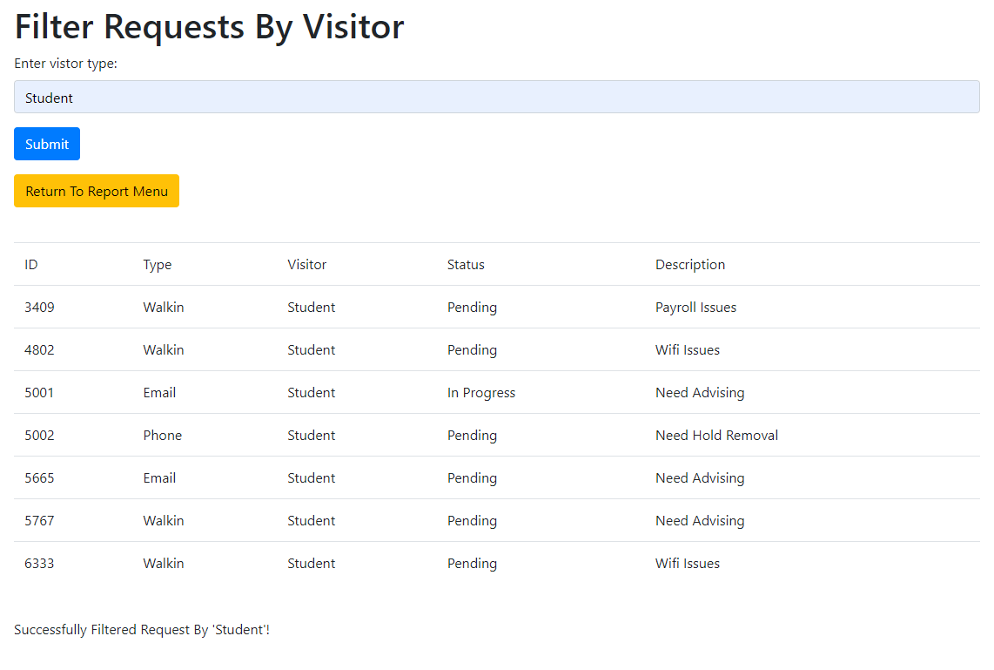
FILTER REQUEST BY VISITOR PROCEDURE

Slide 26
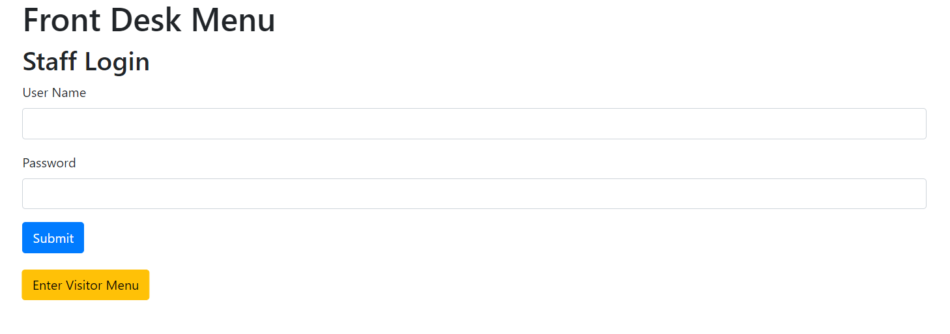
Let’s create a request as a visitor!
Step 1) Select “Enter Visitor Menu” from the main menu

Slide 27
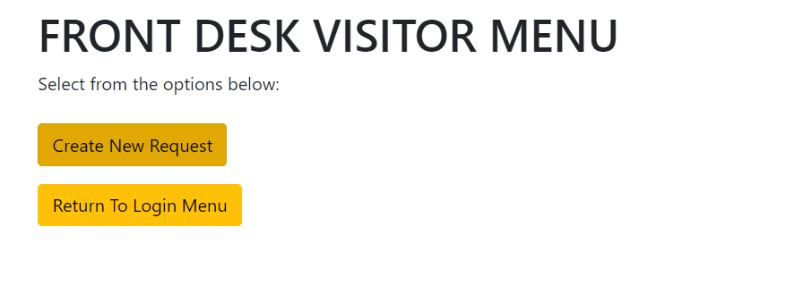
Step 2) Select “Create New Request”

Slide 28
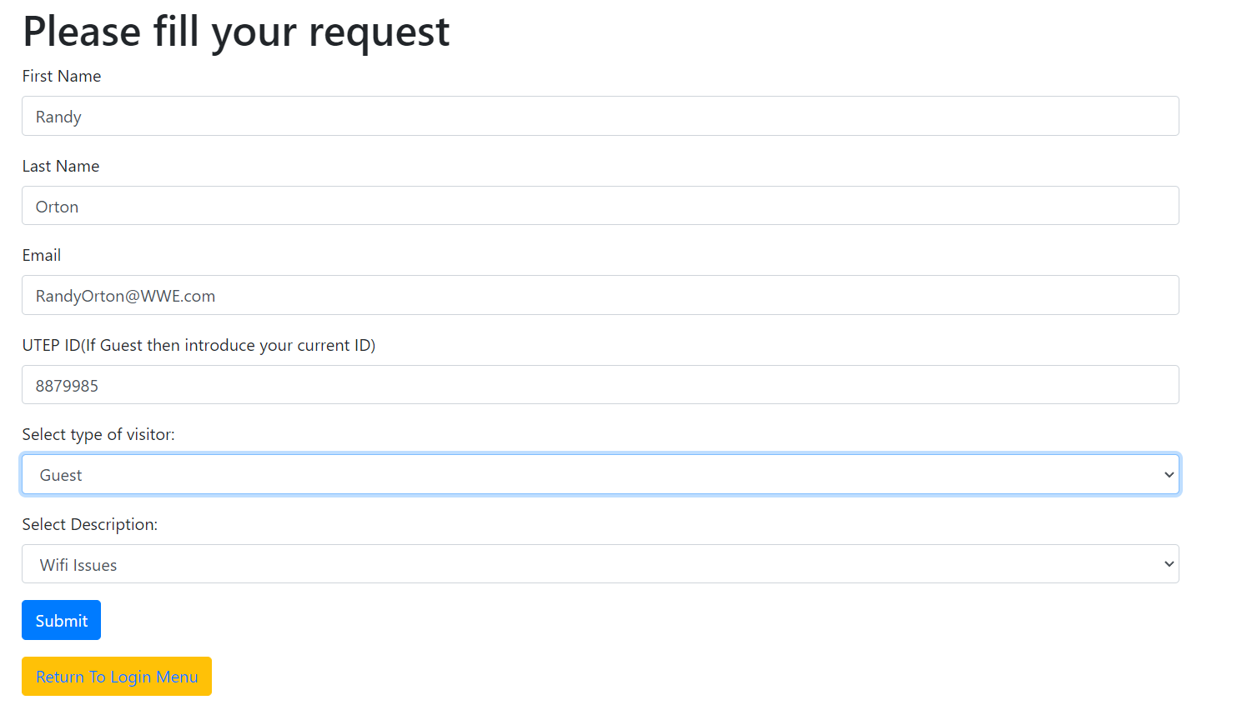
Step 3) Introduce your information and submit it

Slide 29
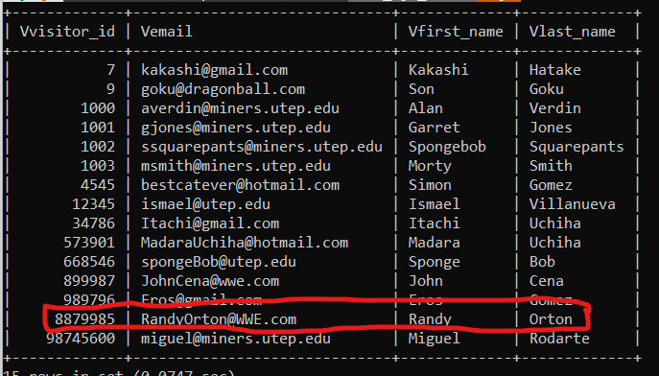
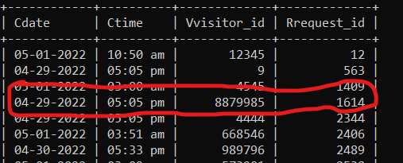
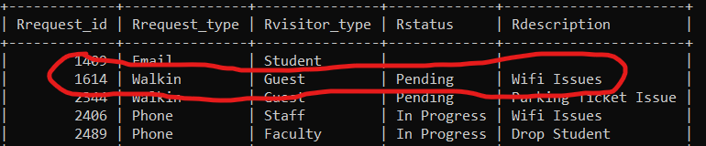
Step 4) Check the results!

Slide 30
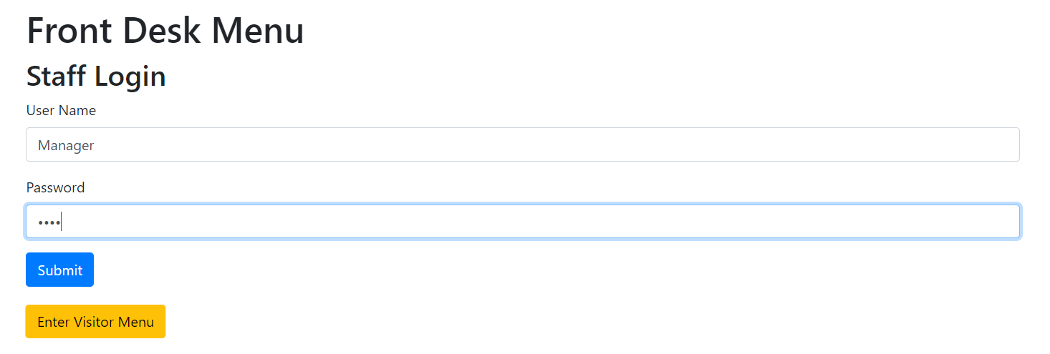
Let’s create a request as Staff!
Step 1) Login as the Manager

Slide 31
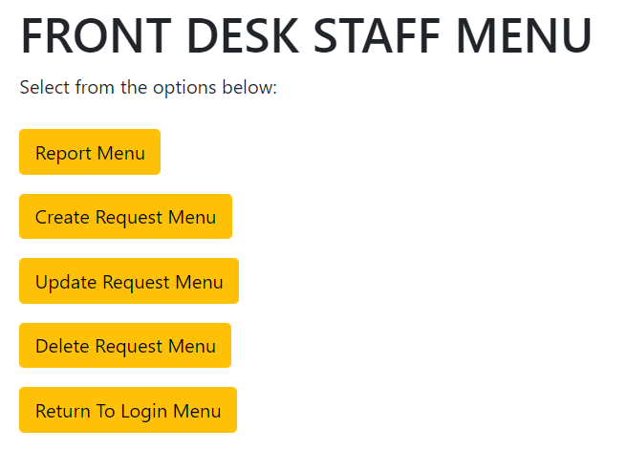
Step 2) Select “Create Request Menu”

Slide 32
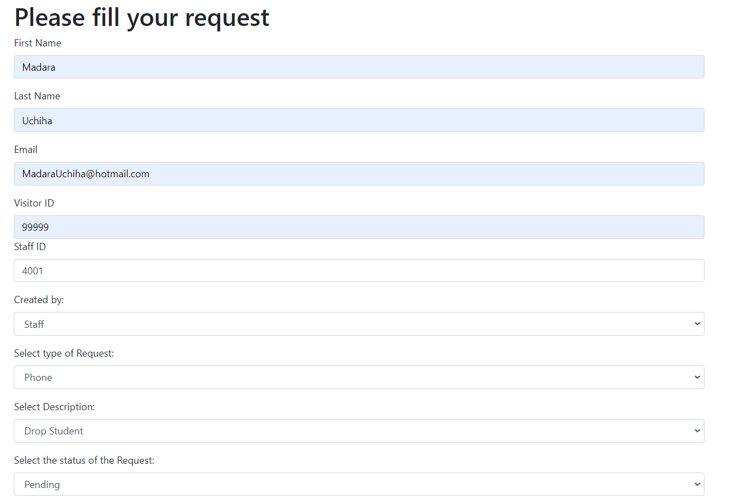
Step 3) Introduce information

Slide 33
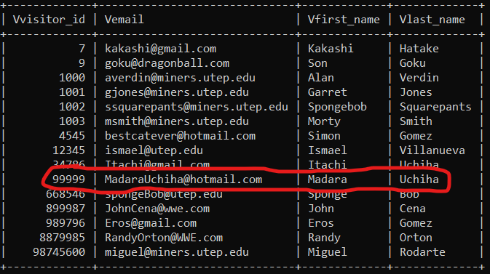
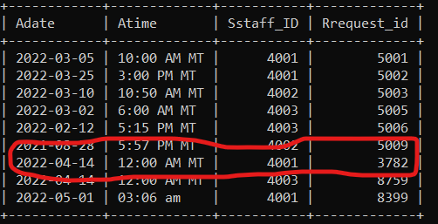
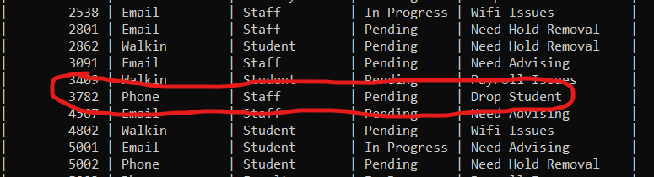
Step 4) Check the results!

Slide 34
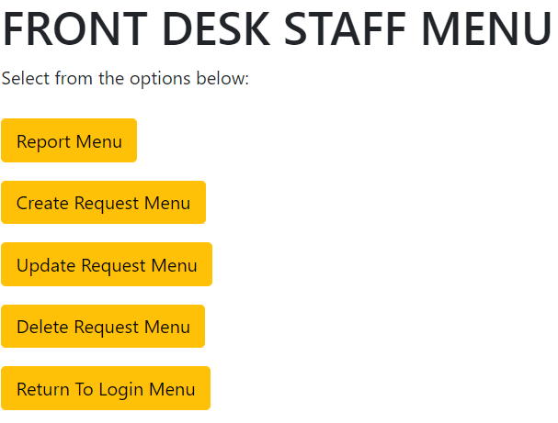
Updating a request (Staff Only)
Step 1) From Staff Menu Click on Update Request Menu

Slide 35
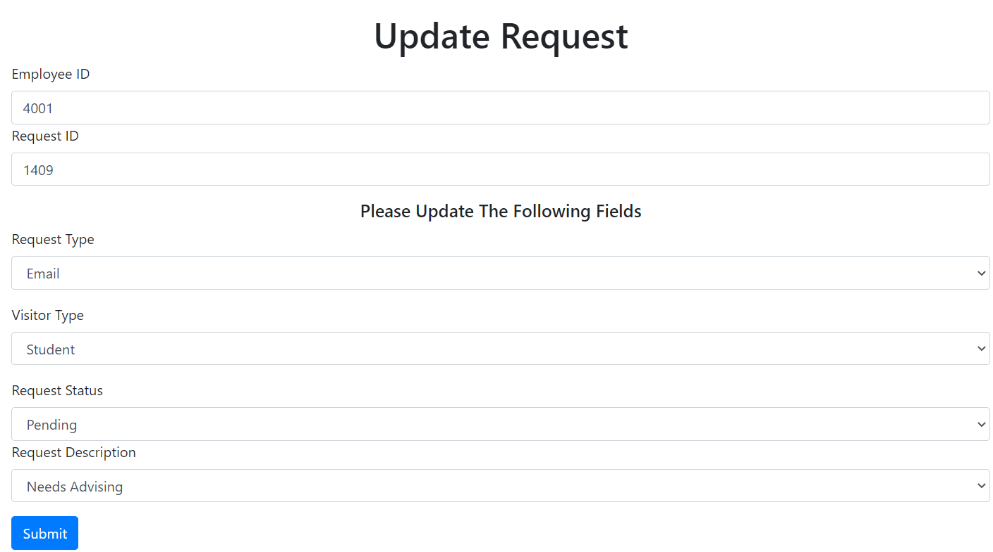

Step 2) Fill fields and Submit
You will get a message if successful.

Slide 36
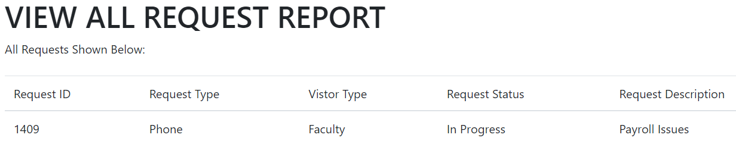
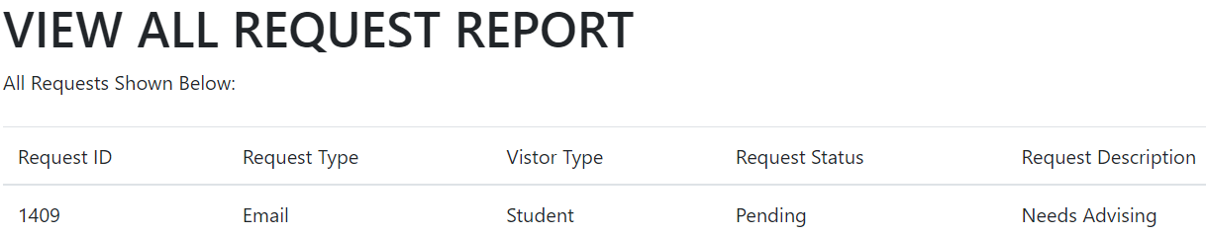
Step 3) Confirm the request was updated.
Request#1409 Before & After
BEFORE
AFTER

Slide 37
Deleting a request (Staff Only)
Step 1) From Staff Menu Click on Delete Request Menu

Slide 38
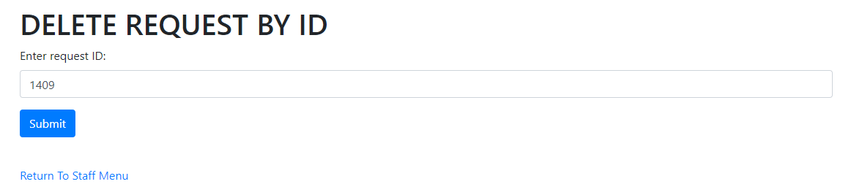

Step 2) Fill field and Submit
You will get a message if successful.

Slide 39
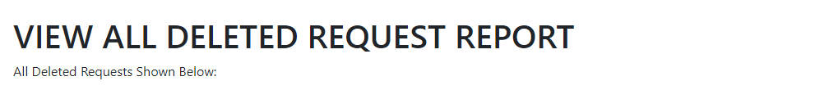
Step 3) Confirm the request was deleted.
Request#1409 Before & After

Slide 40
GUI DEMO
If time allows, here is the link to launch the Front Desk System.
Staff Login:
Username: Manager
Password: 0000
Link:
https://cssrvlab01.utep.edu/Classes/cs4342_5342%20Dr.%20Jimenez/Team5%20jimenez/FrontDesk_Php/index.php

Slide 41

Thank you for your time!

